Slide 1
Problem Statement

Slide 2
The El Dorado Company
The client is an online retailer whose major customer base is in India along with China and Australia. Their current sales are through stores in these regions, an online website, and orders via emails.
Problem Faced: These sales platforms run in silos with no data sharing which is resulting in sub-par customer experience and decline in sales.
Requirement: fast, secure, and reliable website.
They are planning to do a global launch which will do international shipping. They are expecting a 10 times growth.
Key Features:
Store Application (Customer facing)
Account
- Login
Registration
Support email verification
Enforce password policies
- Build user profiles (name, email, addresses)
- Change Password, Forgot Password (support email verification)
- Password Expiry (every 90 days)
- Modify Account Details / User profile details like add/remove addresses
- Logout
Key Features:
Product Listing Page
- User can a see a paginated view of available products with product thumbnails and price, name.
- User can search a product by name or description (Fuzzy search enabled)
Product Detail Page
- User can view a product in detail (name, description, price, available variations, product images, reviews & comments, user manual pdf or any attached documents)
Management Application (Admin)
Products
- Admins should be able to create product catalogues
- Create, remove, modify product line items

Slide 3

S.No. | NFRs & SLAs | Status
1. | Secure access over HTTPS/TLS (Encryption over wire)
2. | Page view times < 3s | 1.6s
3. | Response times < 3s, 1s | 80ms- 2.5s
4. | Throughput - Req/Sec - 50, 100 .... | 500-4500
5. | Availability - 99.999
6. | Concurrent user - 50, 100, 150... | 500-10000
7. | Scalability of User Search per day - in an increasing trend (100,200, 400...) | 5000
8. | Accessibility Responsive - supported view port 767px (Tablet and Desktop)
9. | CI&CD Pipelines to be deployed via Jenkins | Docker
10. | Proper Error page should be displayed
11. | Continuous failures shall be communicated at priority via alerts to the support teams to be acted upon“

Slide 4
S.No. | Engg. PoV | Status
1. | 100% method coverage | 100%
2. | 80% block/line coverage | 85-90%
3. | Code Quality - 0 Blocker, Critical & Major issues reported by SonarQube, ESLint
4. | Code Complexity, Memory profiling, Unit Test Reports, Monitoring & Alerting
S.No. | Testing | Status
1. | Unit Testing
2. | Cucumber BDD
3. | Unit Test coverage FE > 70% | 90 %

Slide 5
Product Development Phase
Logout
Authentication & Authorization
Jenkins CI /CD pipeline Production Setup
Database Versioning
Database Setup on AWS
Load Test –Run on EC2
Sonar DOJO Integration
Search Functionality
Alerting on Grafana
Bug Fix , Testing
Dry Run , Demo preparation
Sprint 1 Stories Completed
Utility For Bulk data feed & Clean-up
Form Data for manual data creation
Sprint 1
Sprint 6 & 7
Sprint 4
Sprint 5
Sprint 2
Sprint 3
High Level design
Low Level Design
Database Design
Cloud Platform
Jenkins CI/CD
UI Mocks
Branching Strategy
Accounts –Login, Registration, Forgot Password, Change password, Password expiry , Logout
Authentication & Authorization
Paginated View of available products
User can view a product in detail
AWS Setup
Accounts –Login, Registration, Forgot Password, Change password , Password expiry, Logout
Paginated View of available products , Filter & Sort Products
User can view a product in detail, Rating , Variation & Admin Operations
Migrating from DynamoDB to MongoDB

Slide 6
Tech Stack

Slide 7
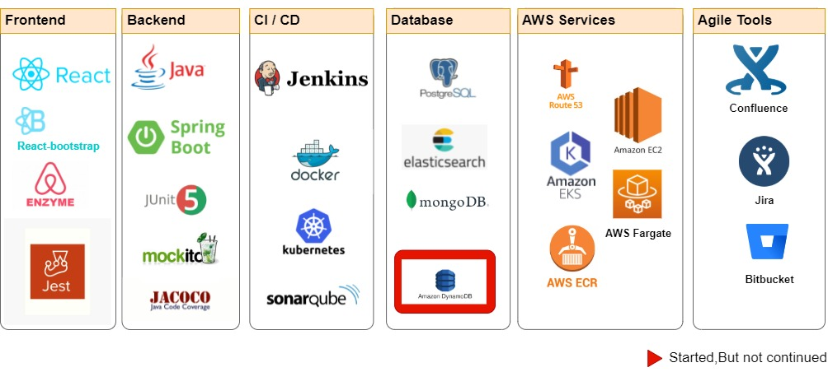

Slide 8
Jira Stages

Slide 9





Grooming
•Acceptance Criteria •NFRs •Story Explained by SME •DOR/DOD
Testing
•Code review •Unit Testing •Performance Testing •Load Testing
Analysis
•Problem Statement
review •Requirement Analysis
Development
•Build •Commit •Peer Review •Integrate

Slide 10
Application Flow

Slide 11
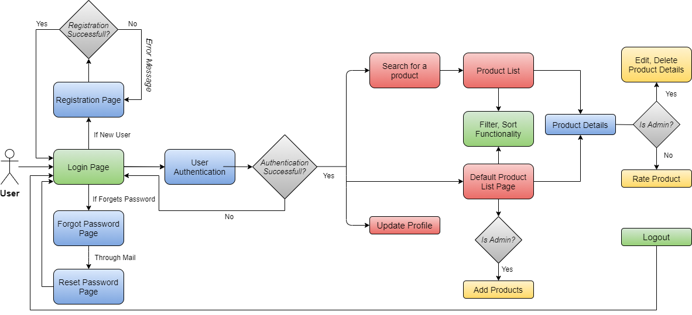

Slide 12
System Architectures

Slide 13
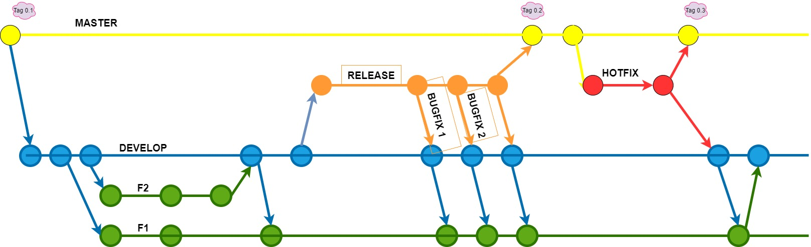
Branching Strategy

Slide 14
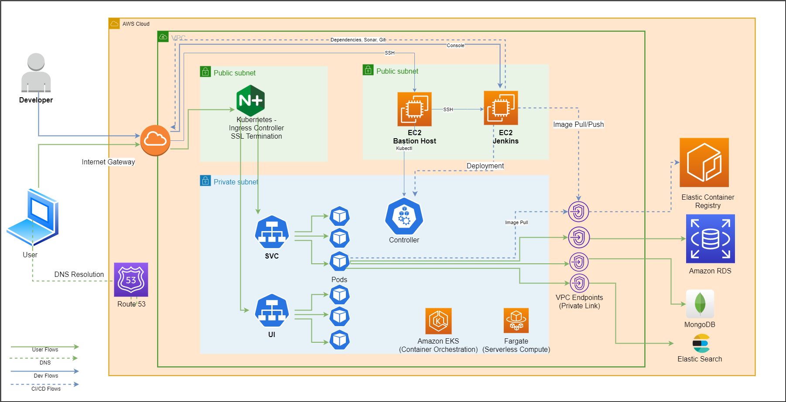
AWS Architecture

Slide 15
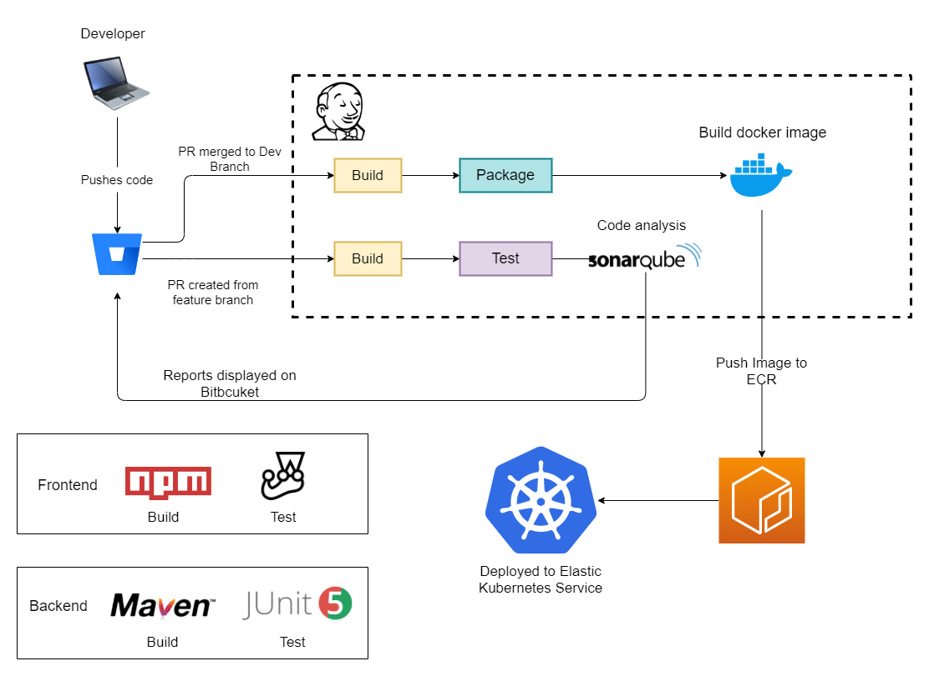
Deployment Flow

Slide 16
Jenkins Pipeline

Slide 17
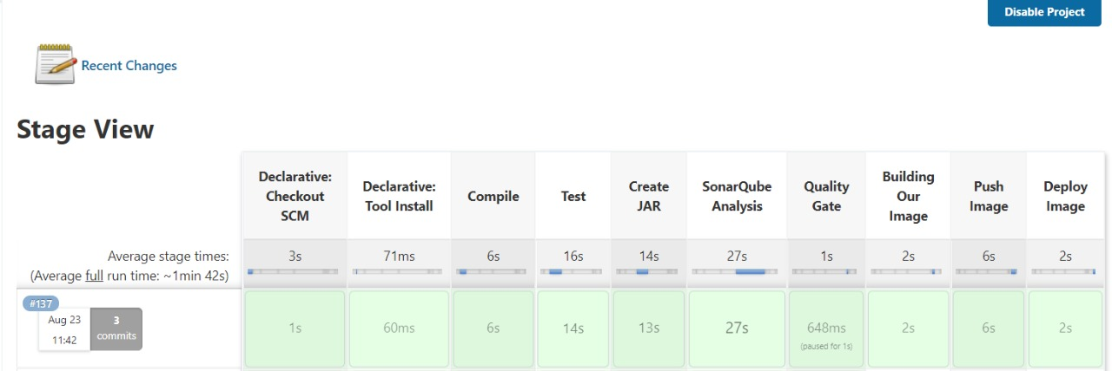

Slide 18
Performance NFRs

Slide 19
Load Test Results:
 | Virtual users | Throughput | Avg. Response Time | 95th Percentile
Search | 1000 | 991 | 28.19 ms | 73.79 ms
 | 5000 | 1138 | 1.64 s | 2.95 s
Suggestion | 600 | 589 | 36.81 ms | 98.04 ms
 | 2500 | 595 | 1.57 s | 2.95 s
Product Details | 2500 | 2490 | 32.63 ms | 121.03 ms
 | 10000 | 4421 | 1.44 s | 2.58 s

Slide 20
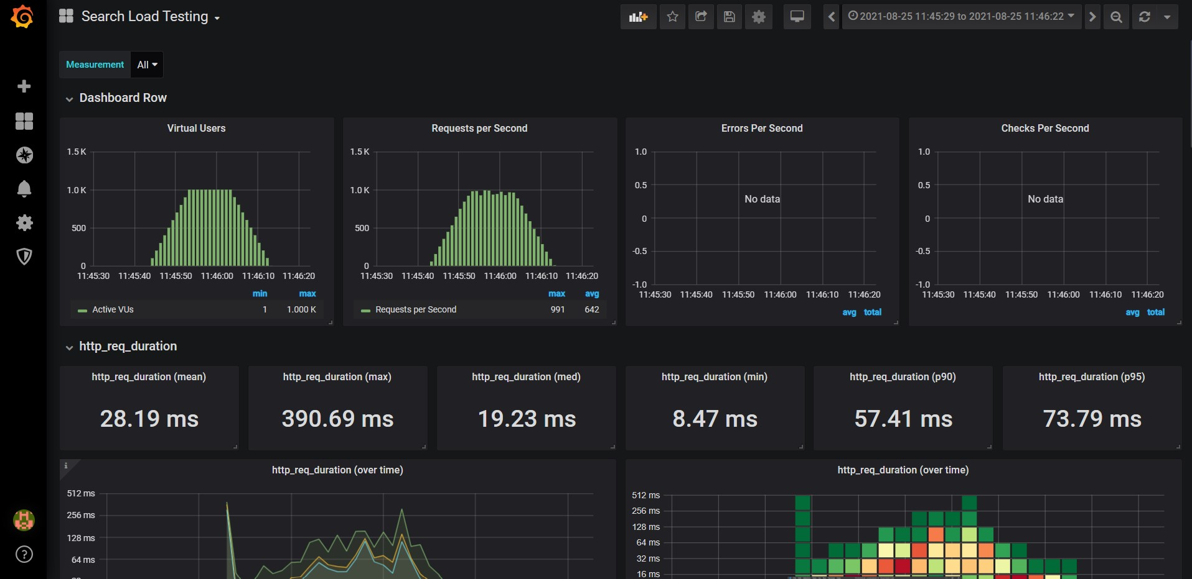
K6 Load testing - Search API (1000 VU 35s)

Slide 21
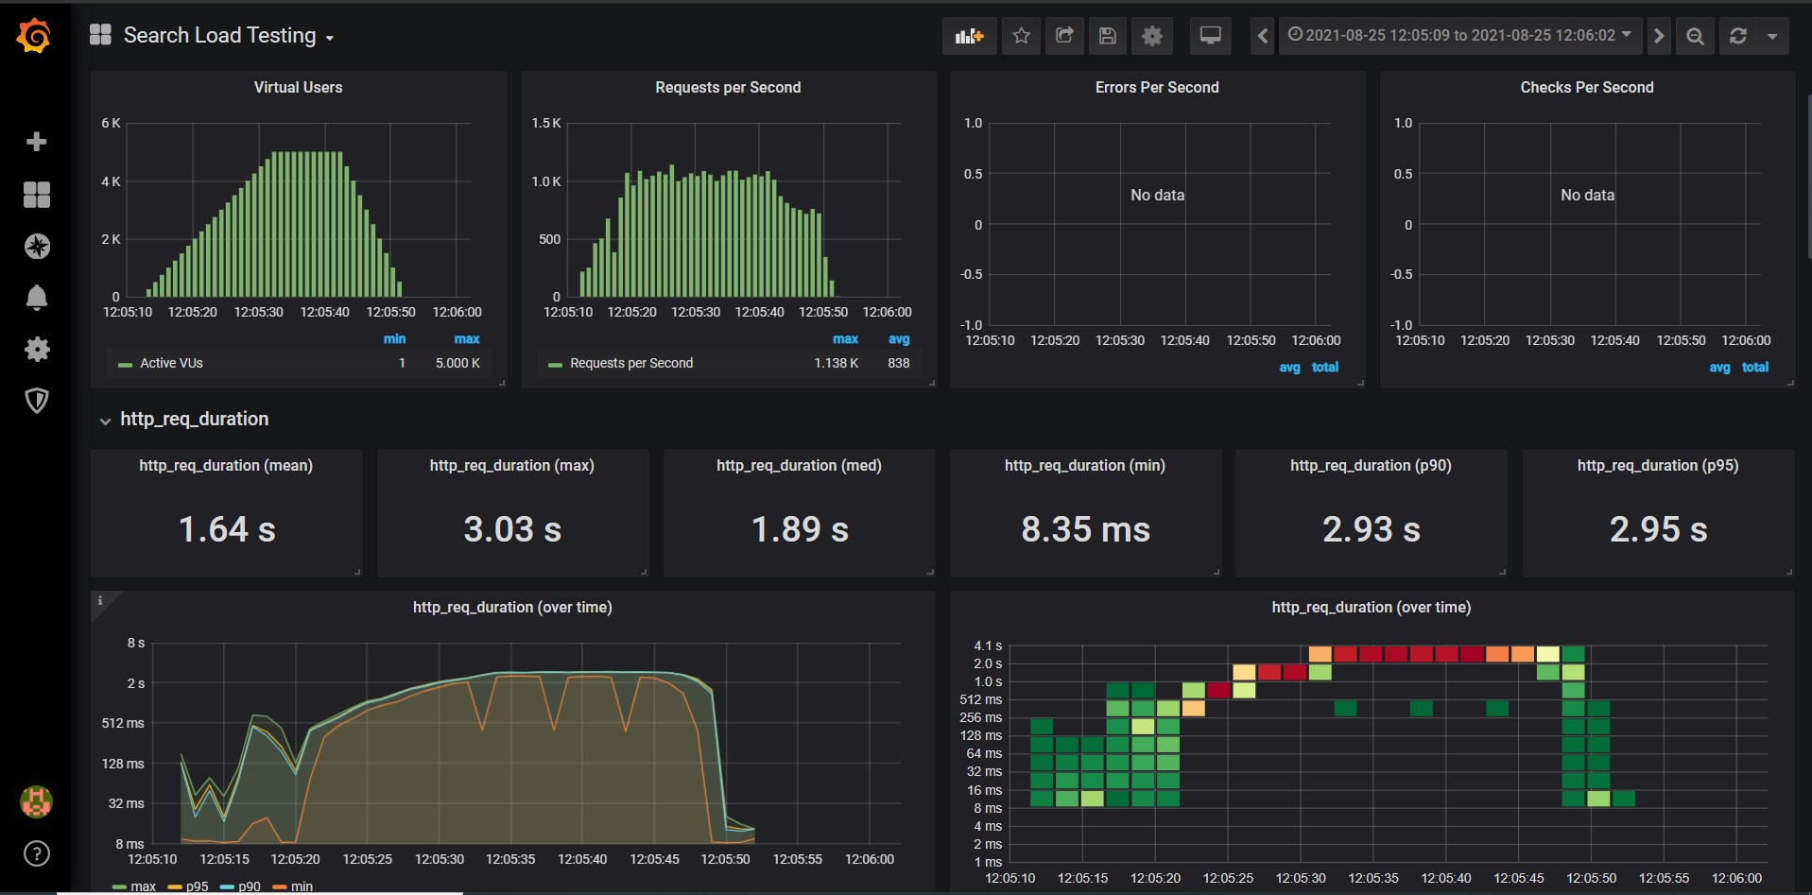
K6 Load testing - Search API (5000 VU for 45s)

Slide 22
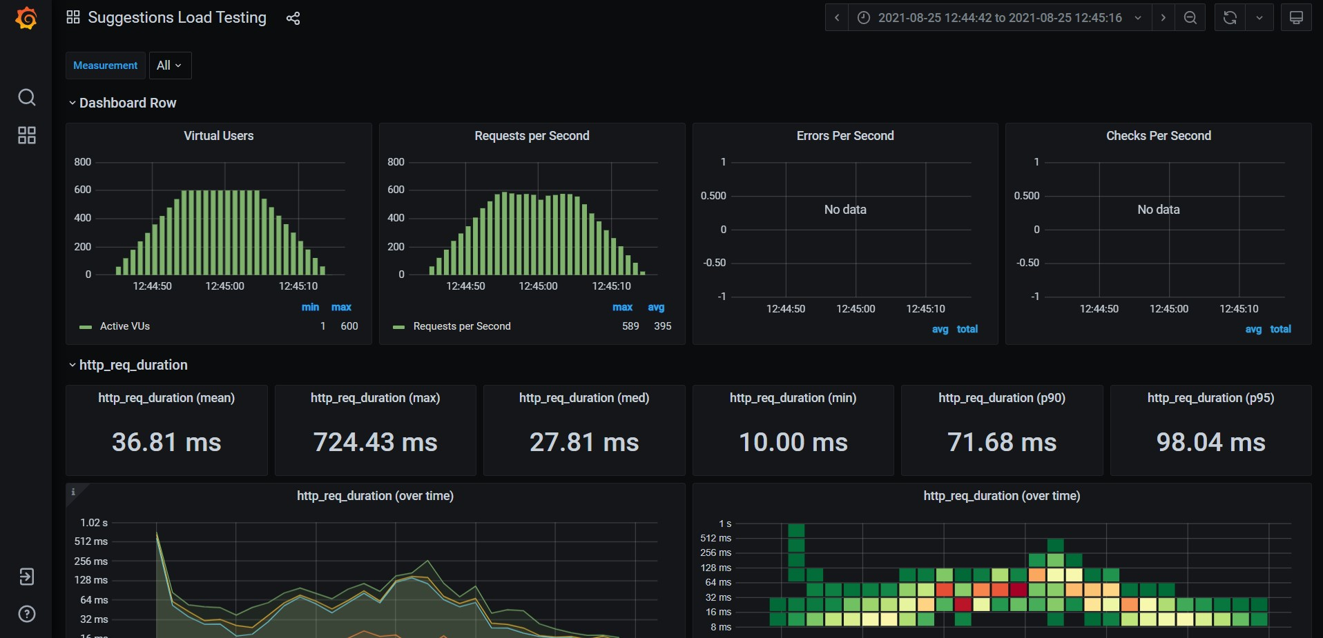
K6 Load testing – Suggestions API (600 VU for 30s)

Slide 23
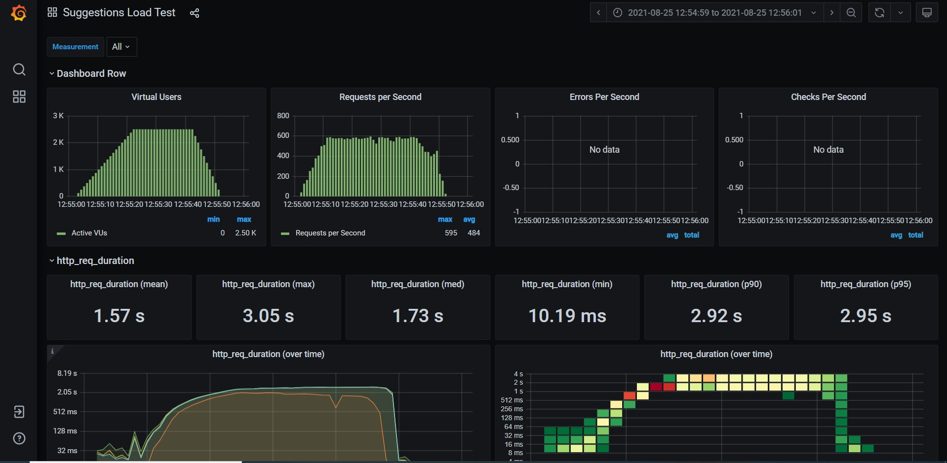
K6 Load testing – Suggestions API (2500 VU for 45s)

Slide 24
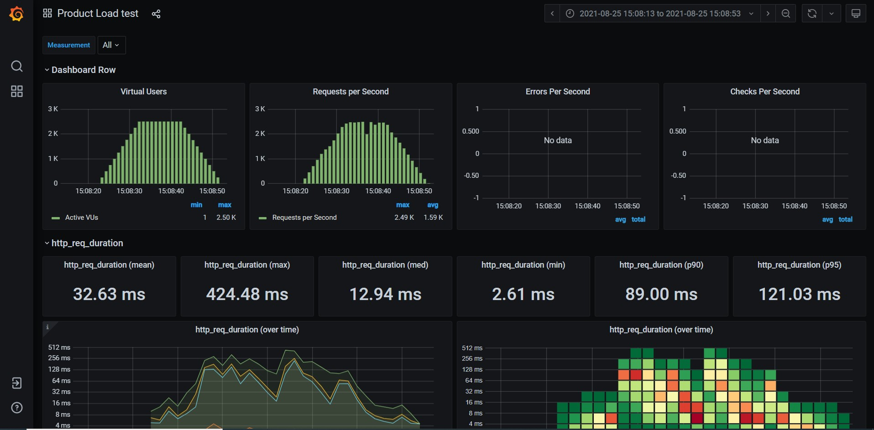
K6 Load testing(Product)Details API (2500 VU for 30s)

Slide 25
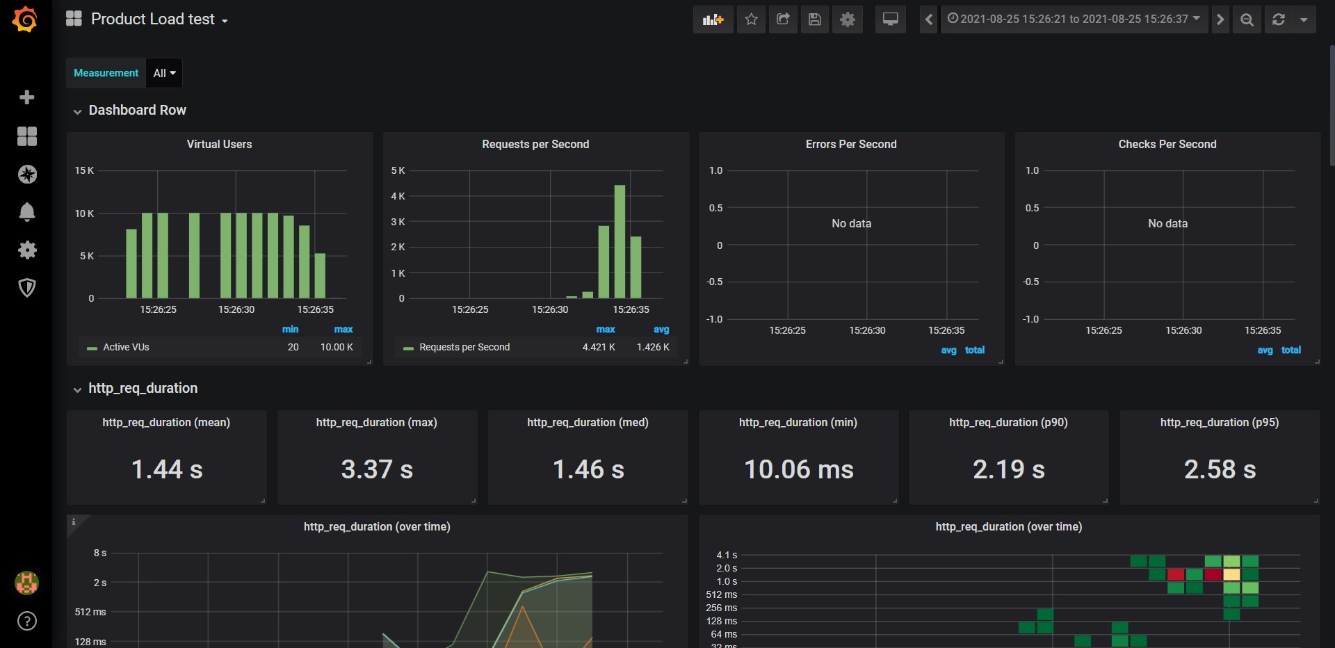
K6 Load testing(Product)Details API (10000 VU for 10s)

Slide 26
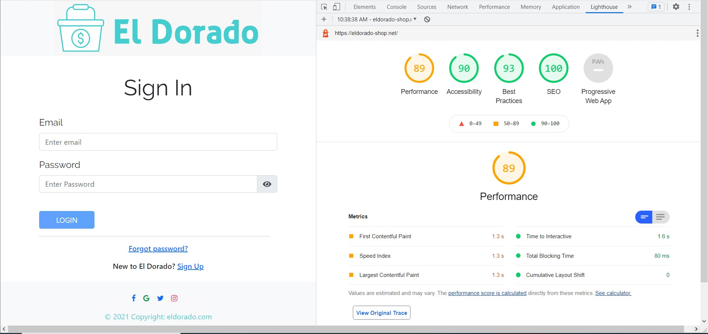
Lighthouse report (Page-render 1.6s )

